Slide 1
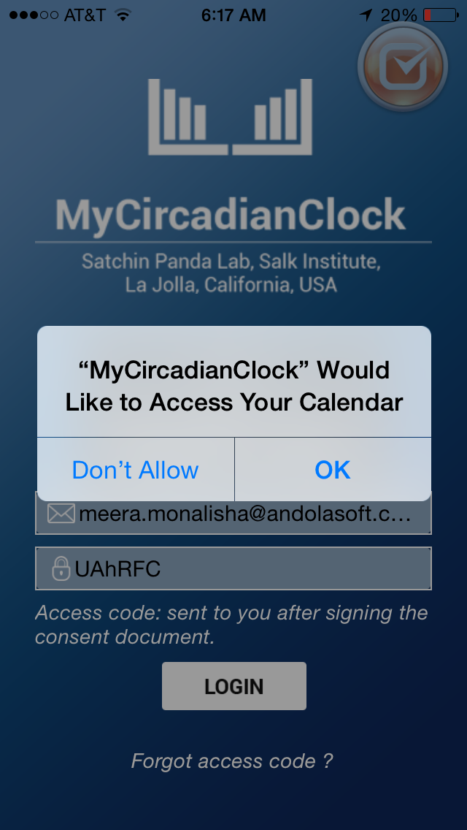
I like the myCircadianClock . It is also on our IRB.
Why does it ask to access calendar?
This app is for research use. You will receive the access code after consenting for the research study.

Slide 2
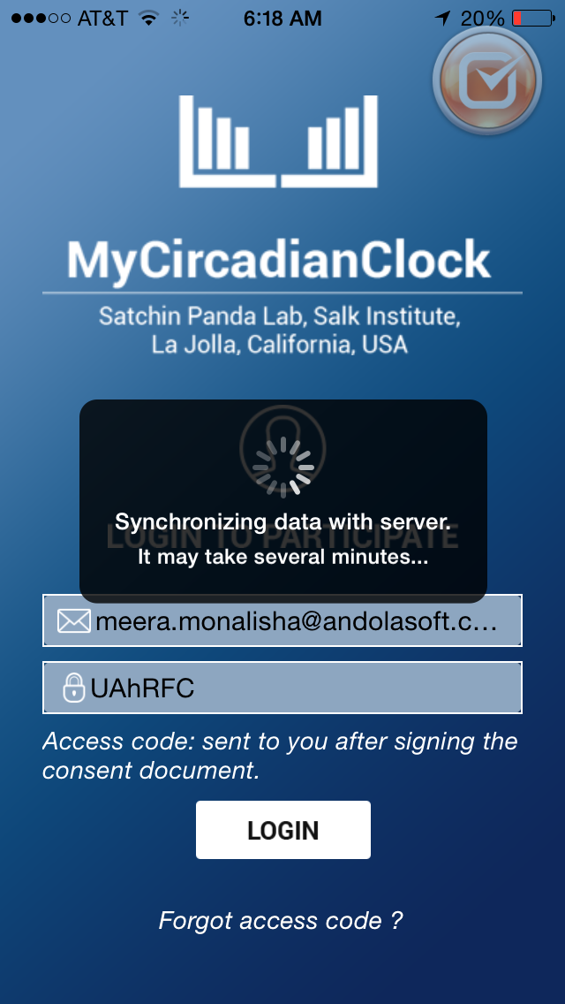
It may take several minutes --> This may take several minutes

Slide 3
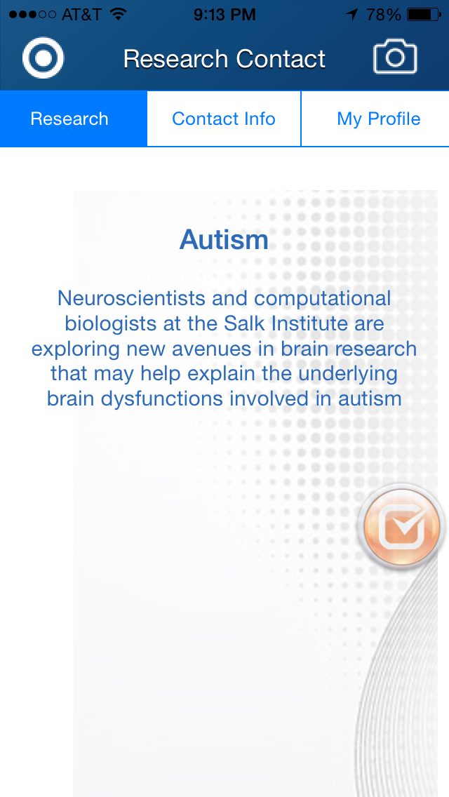
-The dots and fingerprint image looks outdated (this was popular in the 70s) – replace with plain white background.
Replace Autism with something more relevant, even though it's just an example.
Tried to edit it from research information page, but got error messages.

Slide 4
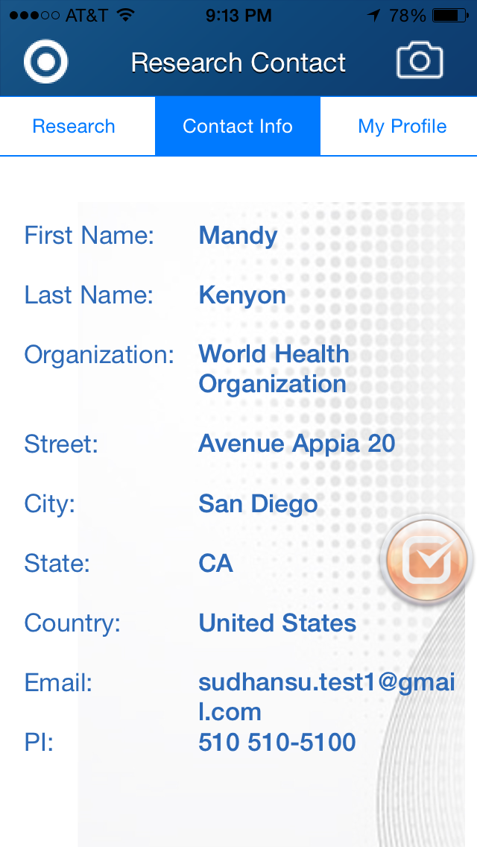
delete
The only thing that will remain is the research feedback – slide 6.

Slide 5
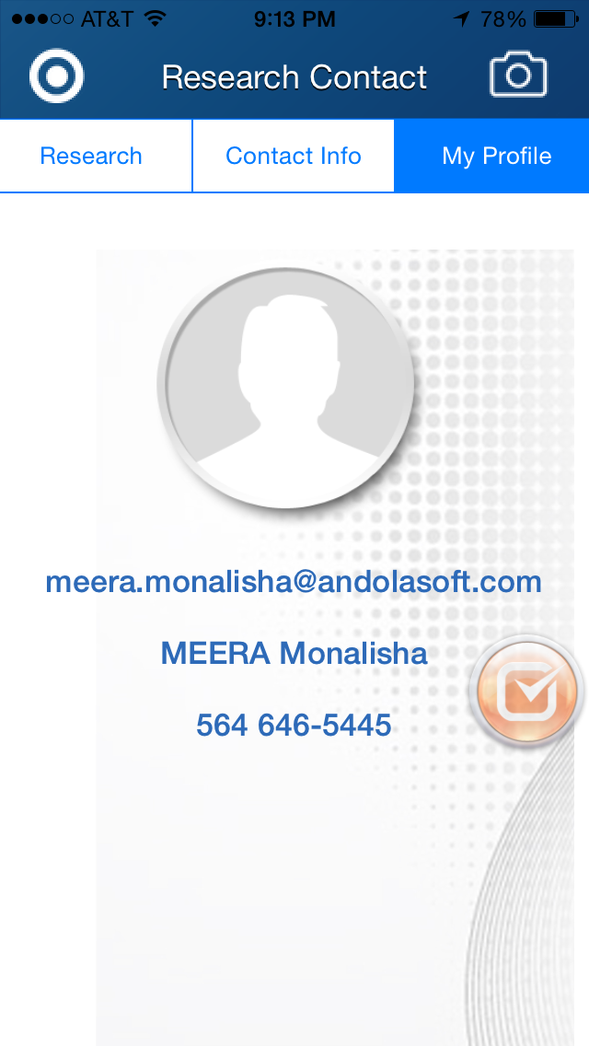
delete
We don’t need “my profile”. When the person signs up, we already get his email and phone number.

Slide 6
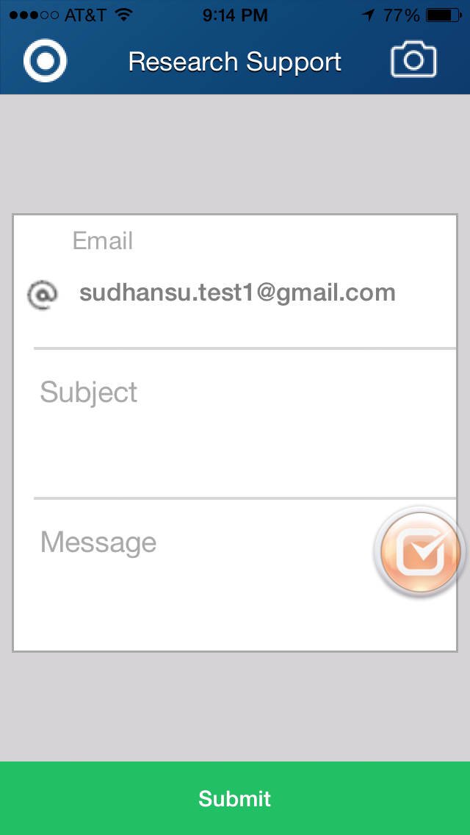
Looks boring. Maybe the backdrop can be like a letter?
Or have a light bulb, like an idea?
Maybe “Question or Comment? Contact researcher.
This email should be hidden. It should only say
“Contact researcher”
We cannot see what is typed and sent to the server. Where do these messages end up?
Notes:
Add feedback menu on the website

Slide 7
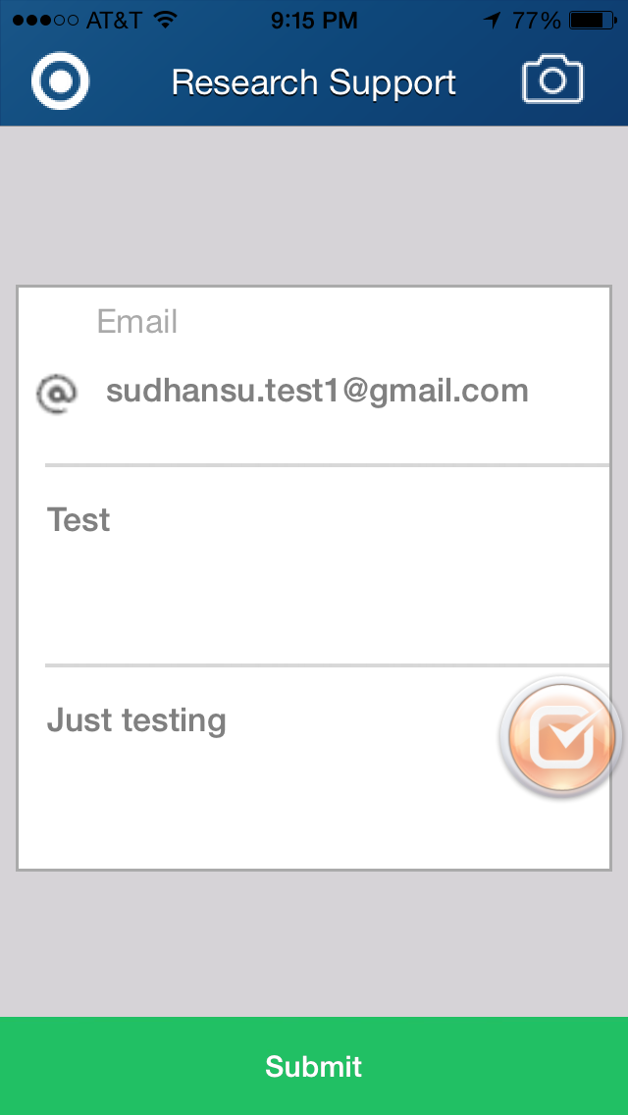

Slide 8
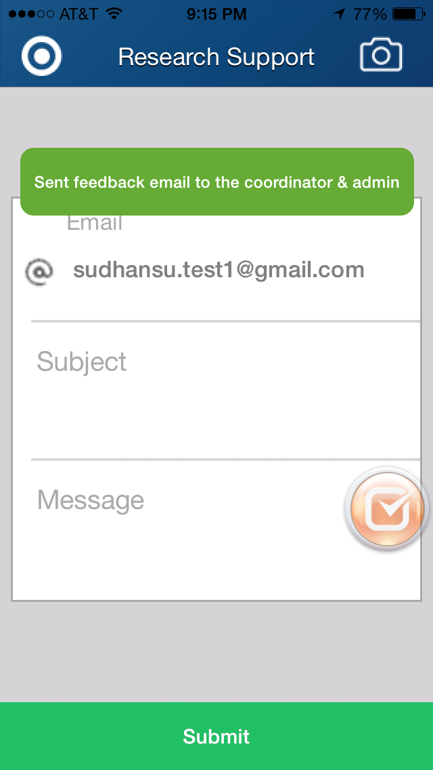
“Feedback sent!”

Slide 9
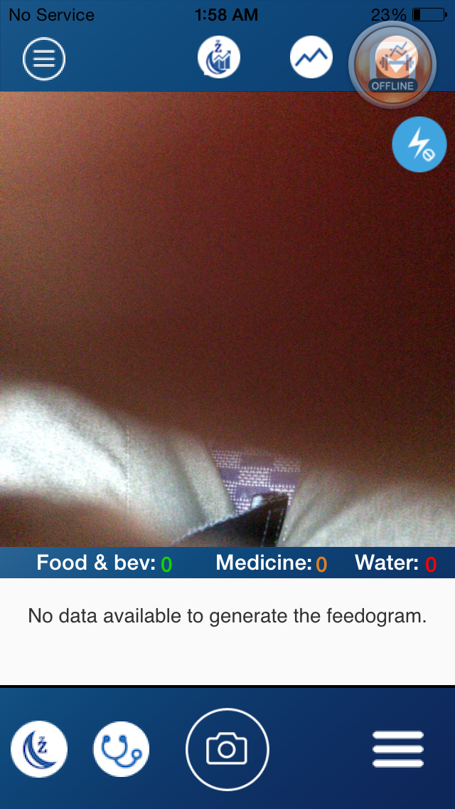
Change to “Start logging your data to see today’s progress”” Or something like that.
“Start taking pictures to see today’s progress”
Food & bev --> Food & Bev. (capitalize b, add full stop after abbreviation)
The numbers and text appear misaligned vertically. (e.g. Medicine and 0)
Notes:
at bottom: sleep and exercise
at the top: sleep, exercise then feedogram

Slide 10
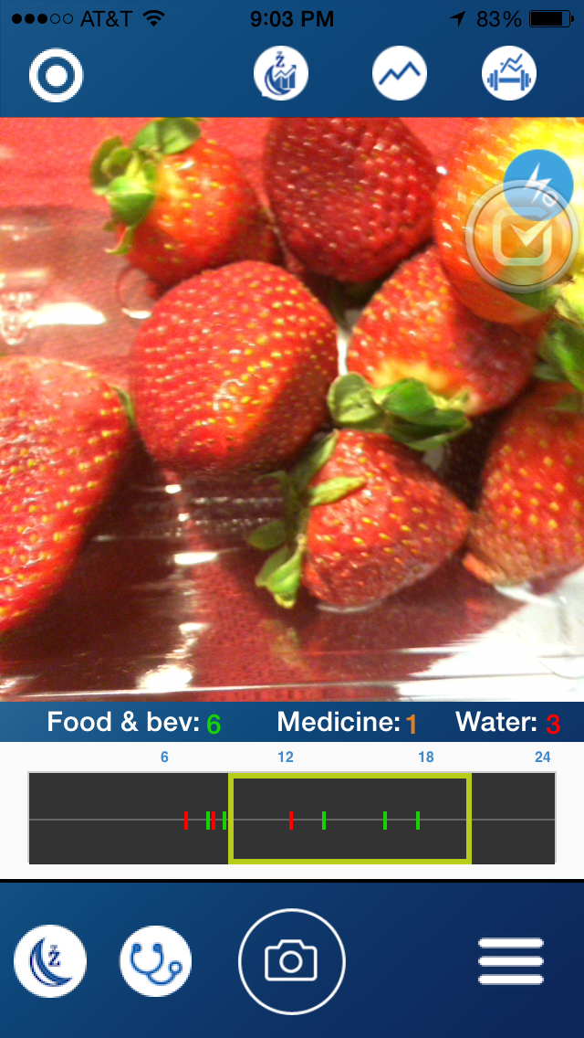
I took --> My Foods

Slide 11
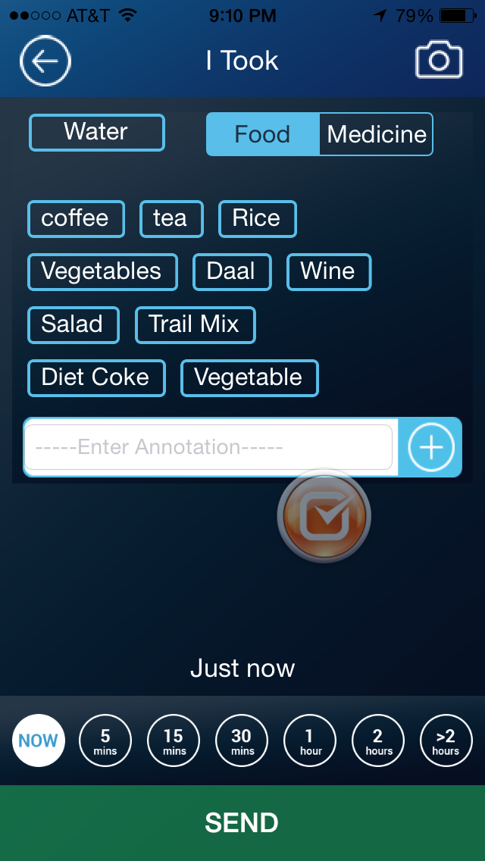
I took --> My Foods
Again, even though this is just an example screen, if it will be posted to the app store, the first letters of coffee and tea should be capitalized

Slide 12
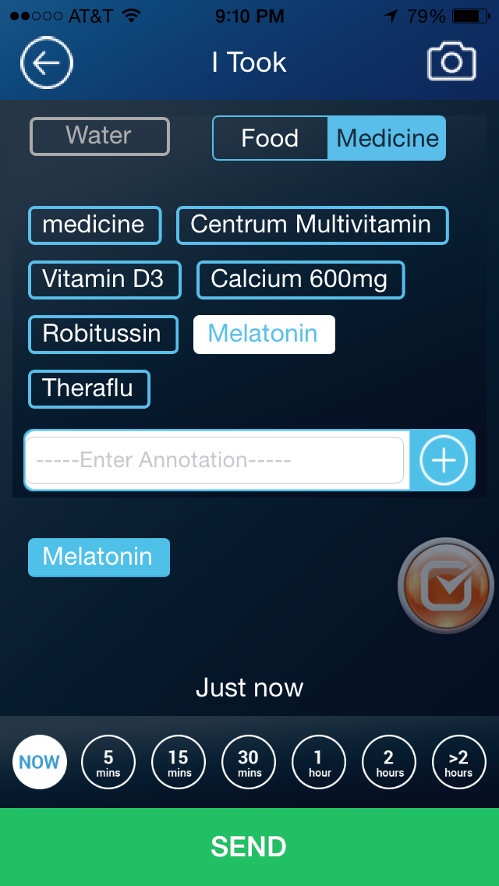

Slide 13
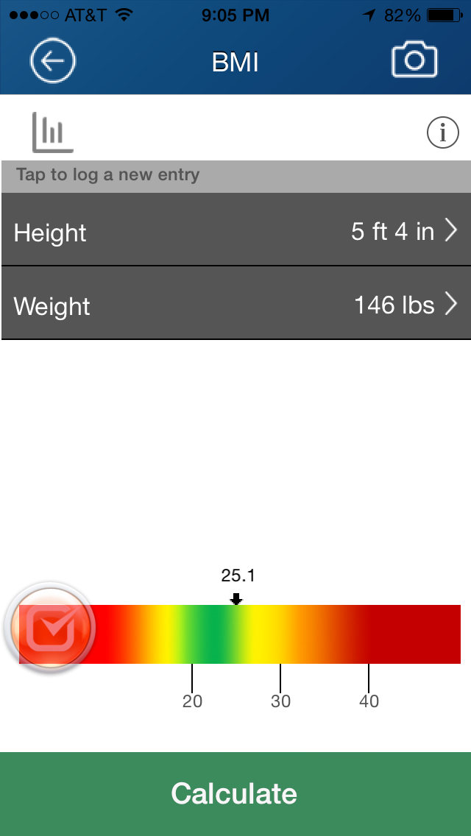
Number could start out at 2ft and 50lbs
Add "BMI" label to the colorbar, it's not obvious what it is otherwise.
Make the lines further apart so green zone doesn’t look so small.
Underweight side should be just as red as overwt.
Scale from 15 to 45.
<16
20
30
40

Slide 14
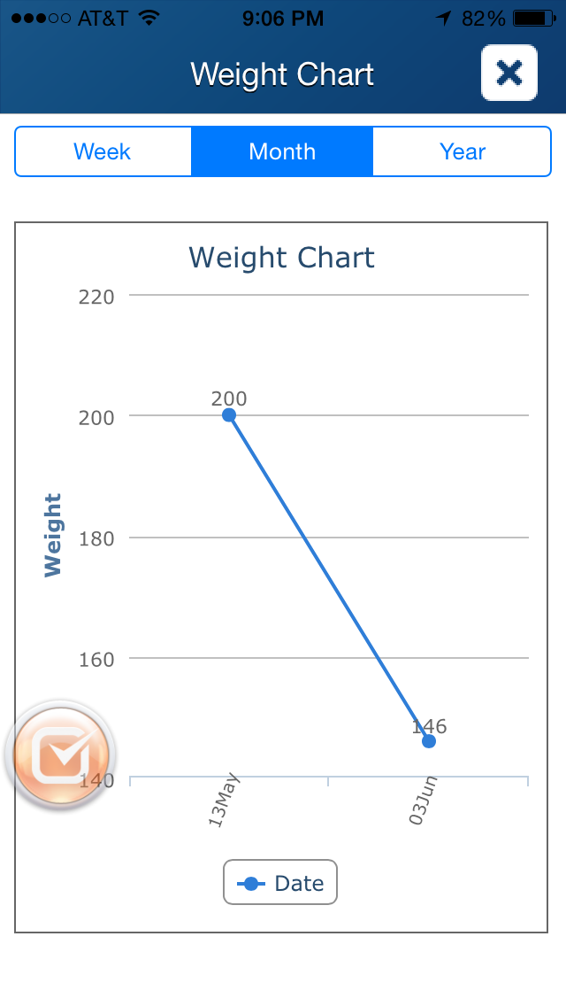
Just “Weight”
No need to say Weight Chart on top of the graph
Weight --> My Weight (lbs.)
Space needed between date and month name (13May --> 13 May). Align them, so that they don’t overlap the axis – same in slide 16.
Notes:
I don't know how to get to this page. This should be more prominent.

Slide 15
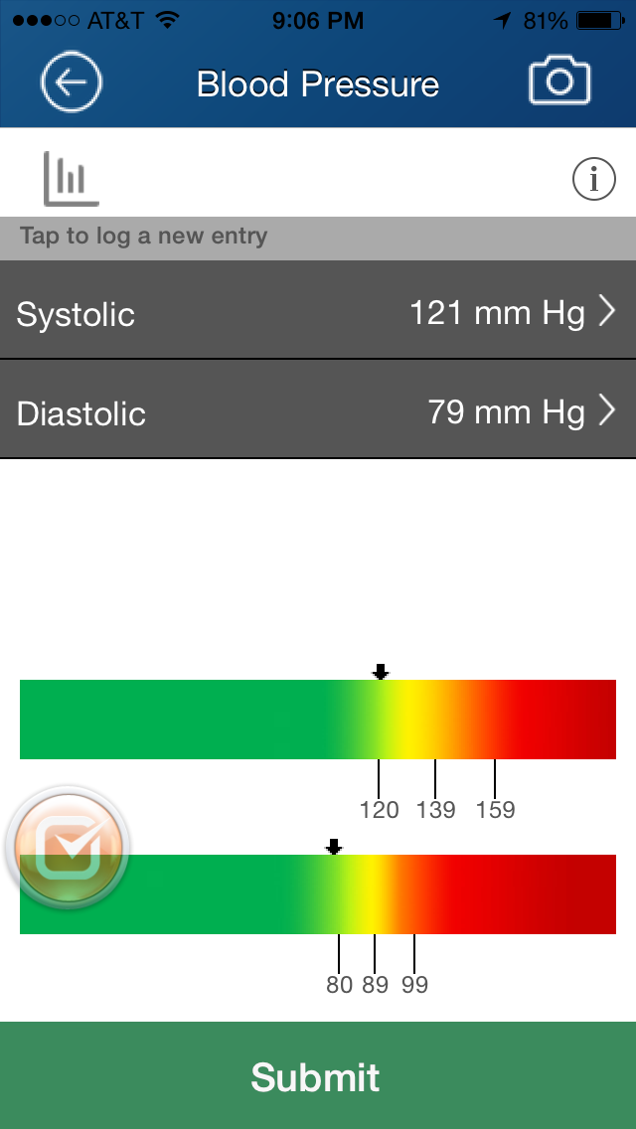
Too much green, spread out lines.
Scale from 50 to 200 on systolic and
Scale 40 to 150
Also if 90/60 should be red on left side, just like BMI

Slide 16
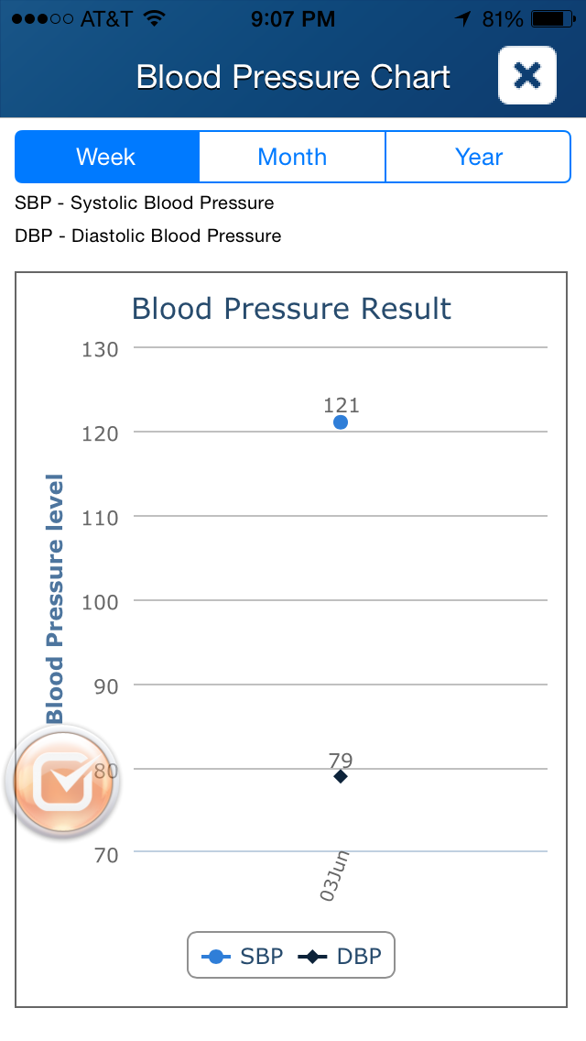
Delete “Blood pressure result”
Put (mm Hg) after “level” on side
Blood pressure level --> Blood Pressure (mm Hg)
There's no need to change the marker type (square vs diamond) when the colors are different for SBP and DBP.

Slide 17
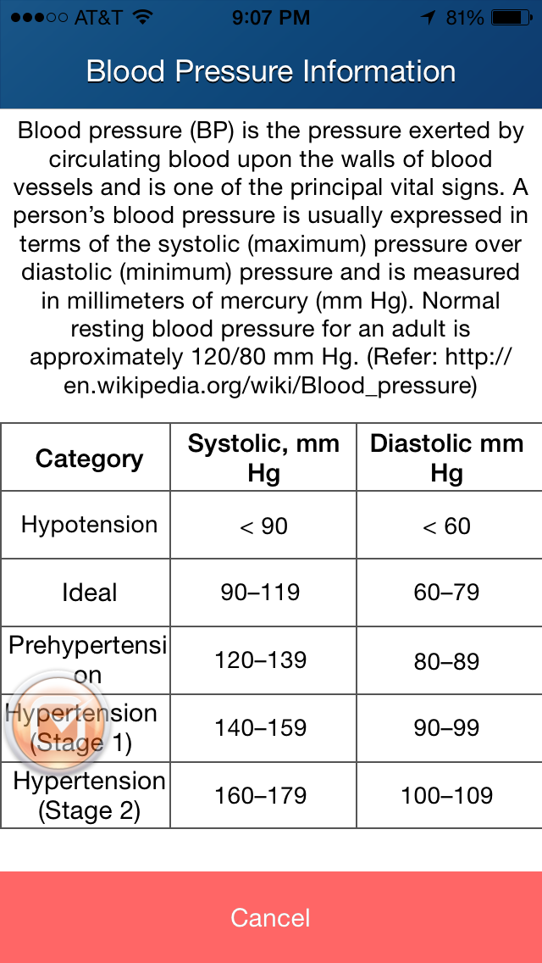
Change the reference from Wikipedia to NIH http://www.nhlbi.nih.gov/health/health-topics/topics/hbp
Needs a comma after Diastolic
Decrease font size of prehypertension so on one line

Slide 18
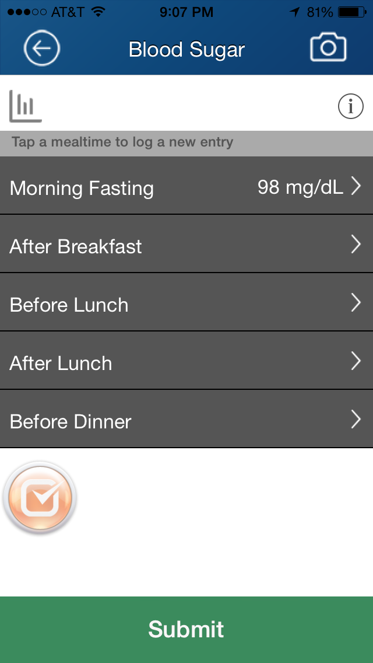

Slide 19
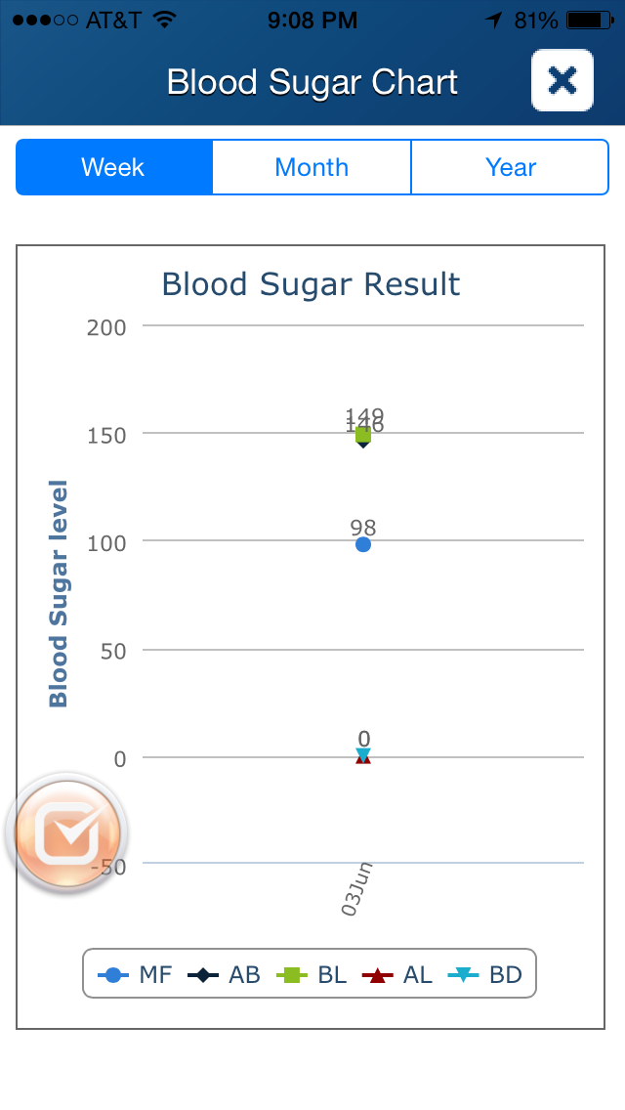
Blood Sugar
Remove Blood sugar result from chart title
Delete “Blood sugar result”
There are two overlapping labels around 150. Not clear why.
Insert mg/dL

Slide 20
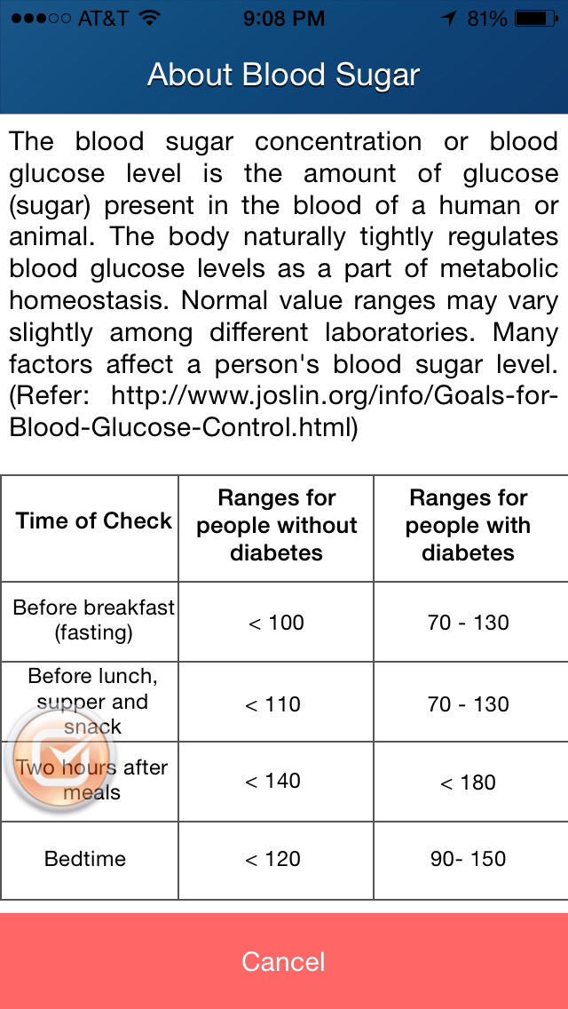
Delete the irrelevant sentence "Normal value ranges ..."
no units are mentioned. So add a sentence Units are mg/dL.
Time of Check --> Time Checked

Slide 21
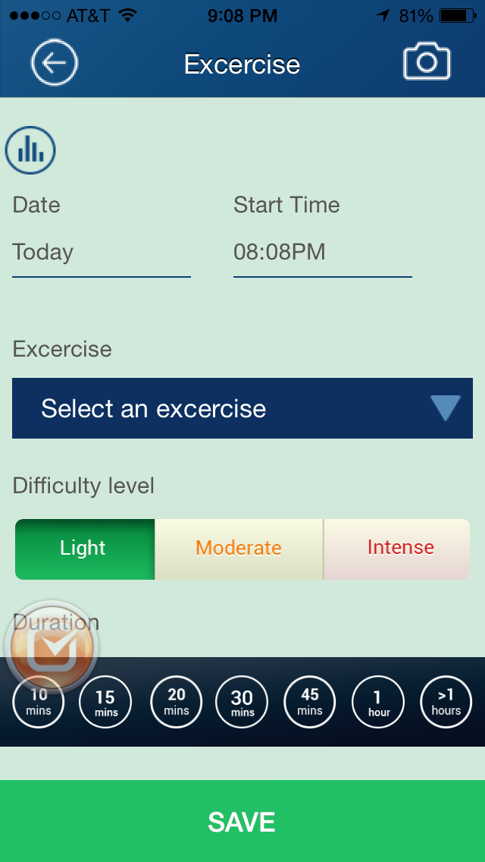
Not sure why I care about difficulty level.
If trying to lose weight any level and they always think its difficult.
If active will say moderate.
But who cares, why does this help me or research?
Might be interesting to see aerobic vs strength to compare AHA guidelines.
Exercise is misspelled everywhere on this screen.
Change background to plain white – same for other screens with similar layout.
Hate this green color. also, the exercise bar has way too many options. This should be an input much like our food annotation input. Most people have no more than 4 or 5 exercises they do routinely. After the first input it is then available to select, just like the food annotations.

Slide 22
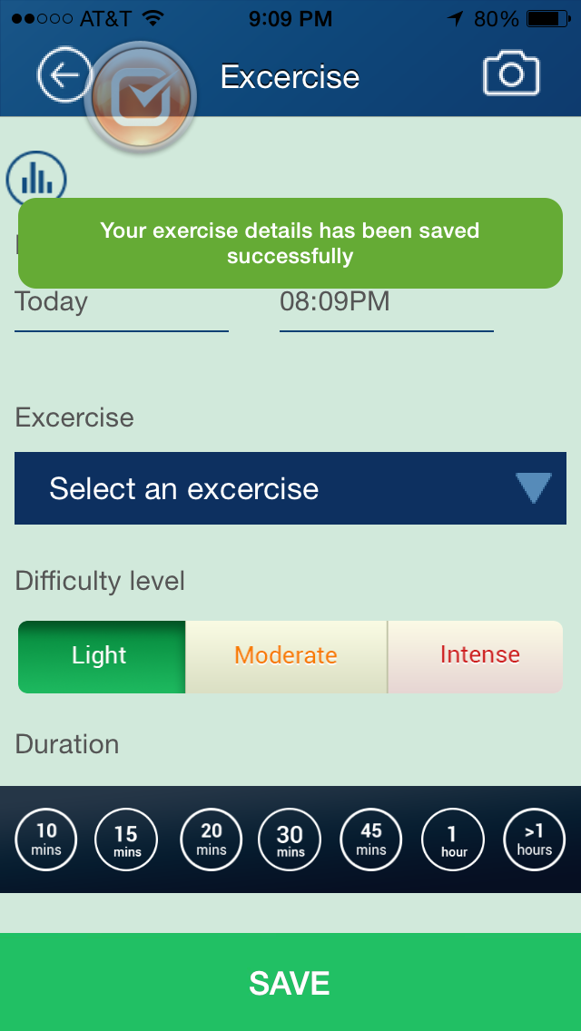
Your exercise details has been --> Your exercise details have been
Difficulty level --> Activity level. Also change in previous screen.

Slide 23
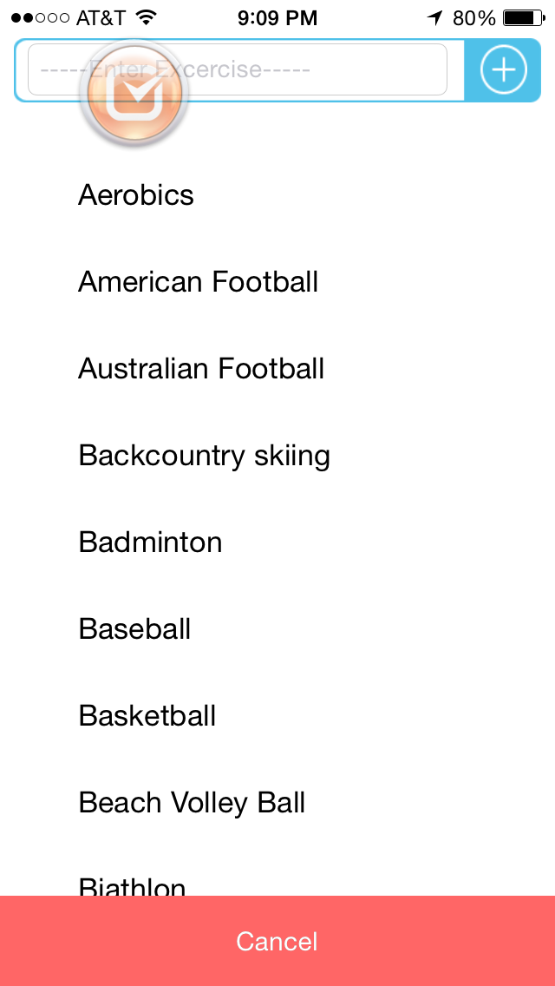
Can this list begin with the participants own inputs/history?
See comments from slide 21. #1 exercise is walking. I can't find it on the list. Should be first

Slide 24
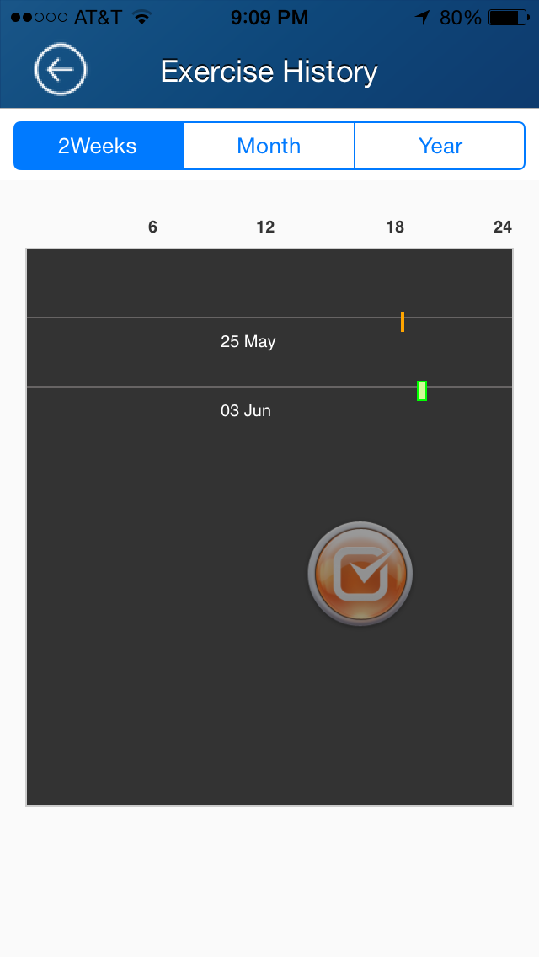
Change to Physical Activity history
Add color legend – light, medium, intense physical activity.

Slide 25
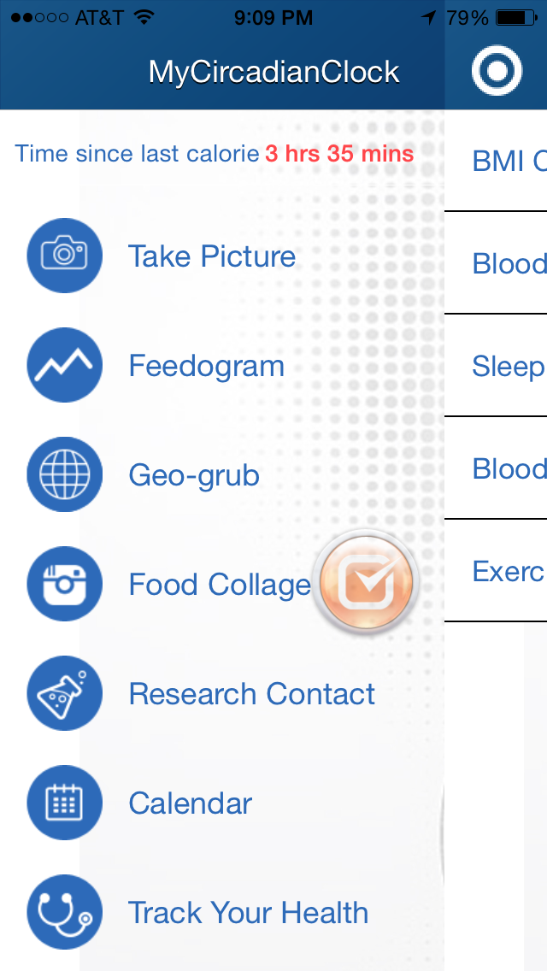
Alot of info everywhere
Get rid of research contact
Rid of blue background on icons, make icons white and dropback page a lighter shade of the power blue

Slide 26
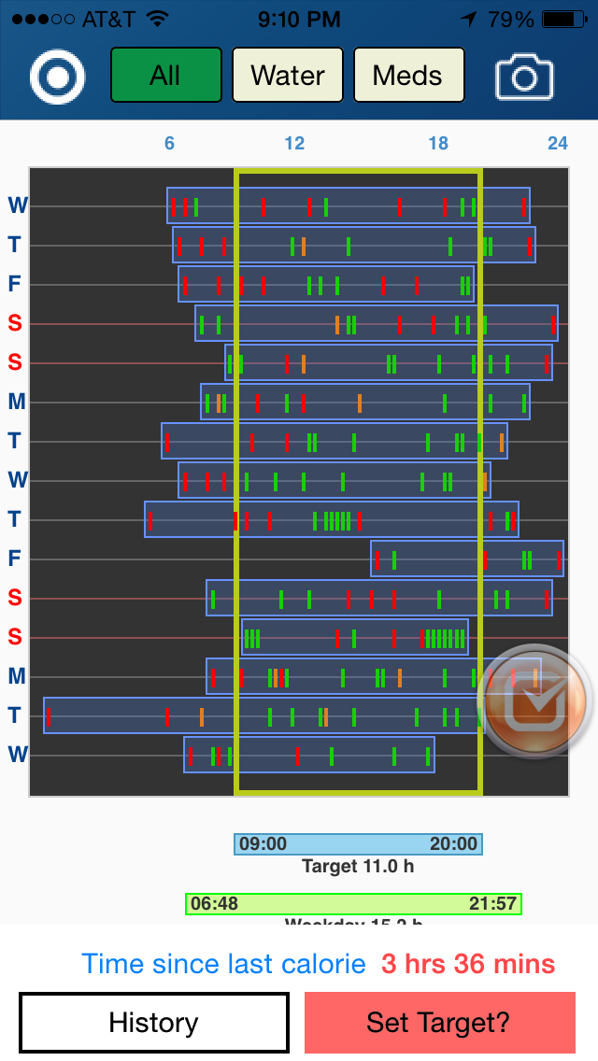
Still like “Actual” over weekday
Trophies at end of day for making Target hours??

Slide 27
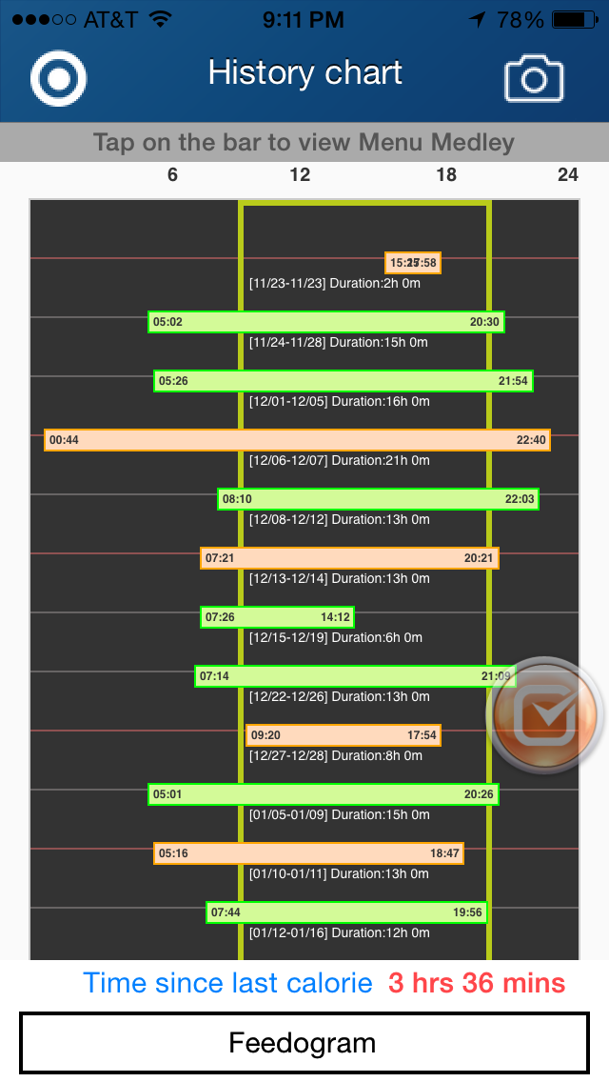
Change title to “Feedogram History”
Why there are two weekdays averages (green)

Slide 28
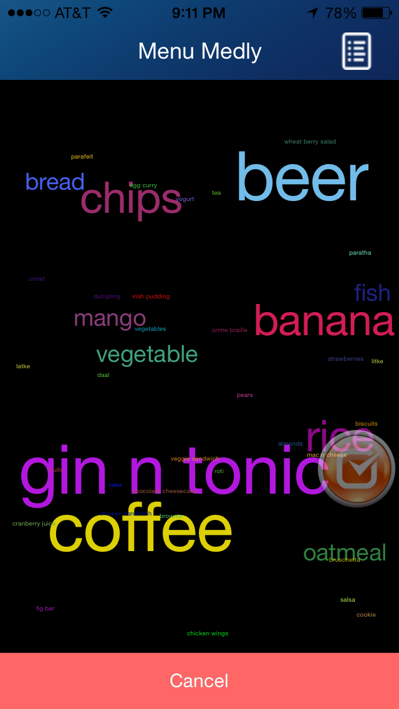
Medly --> Medley
This font should be much funner and bigger. Make sure the smallest font is at least 18 size. The tiny fonts cannot be read.
Instead of cancel button, can we have
“Back”, “Previous week”, “next week”?

Slide 29
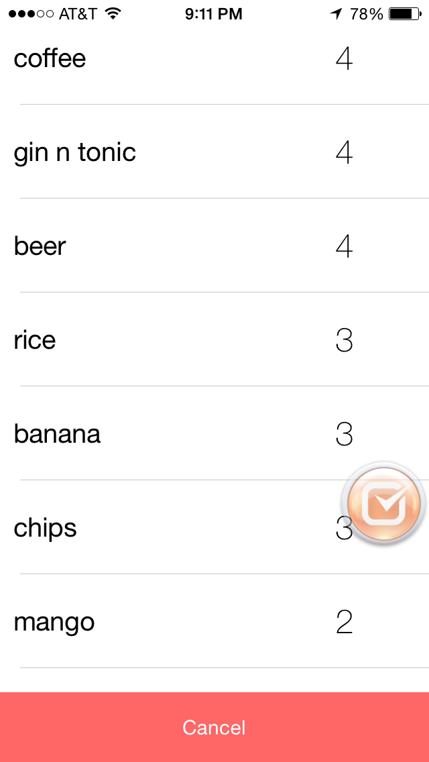
At the end of the list show water, medications.

Slide 30
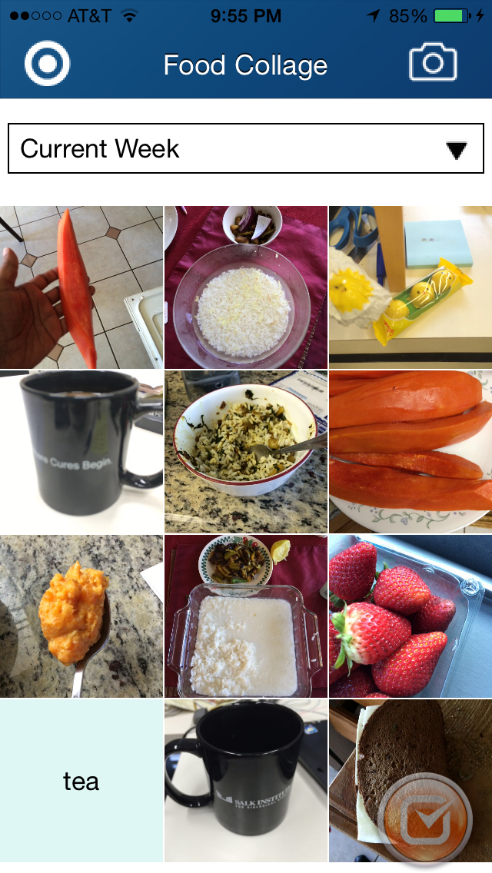
Put a sync button for past weeks.

Slide 31
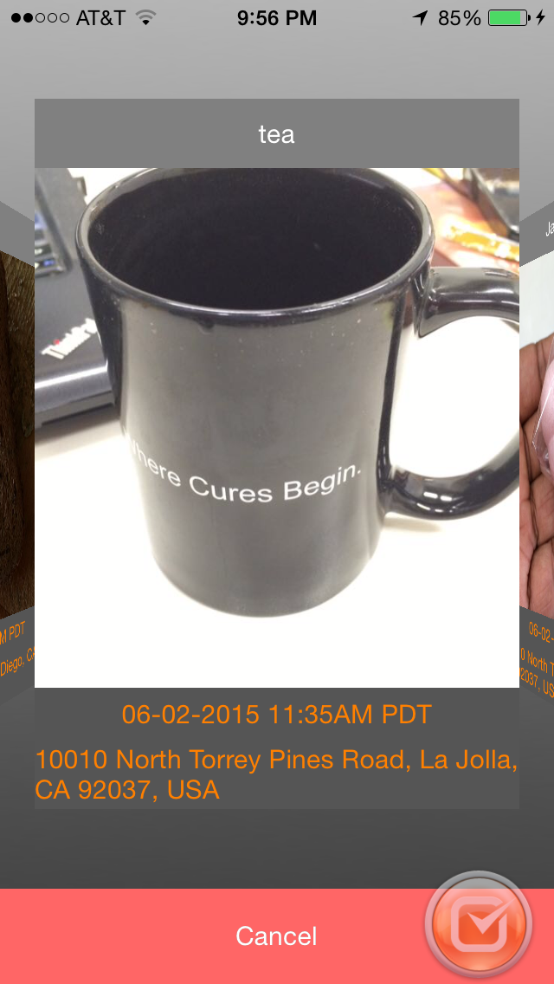
Sync past version pics

Slide 32
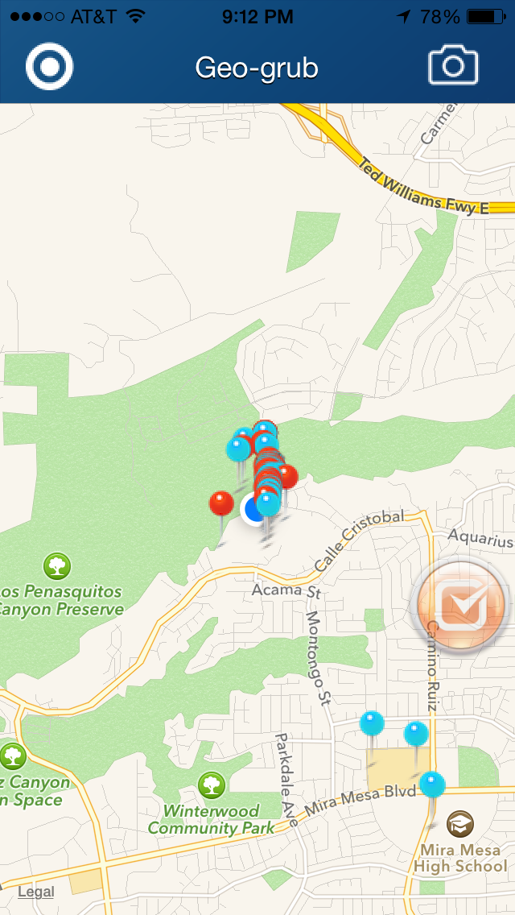

Slide 33
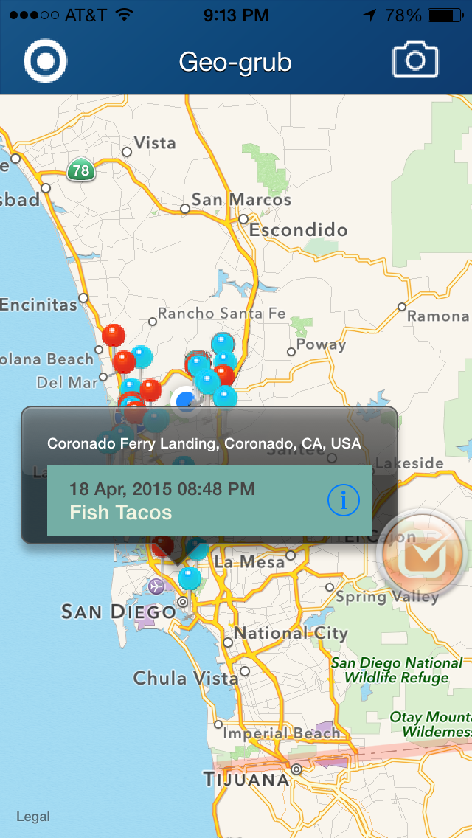
Notes:
slow the animation for the tooltip display

Slide 34
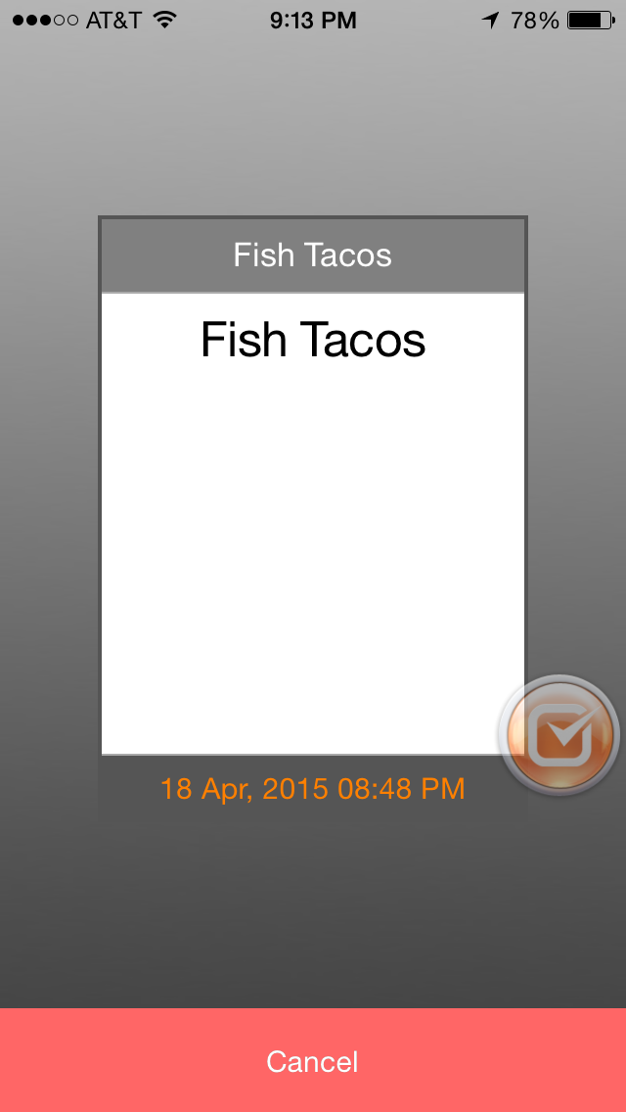
Can this be shown on a transparent background over the map.
Notes:
camera information like light, pixel. Display over the map.

Slide 35
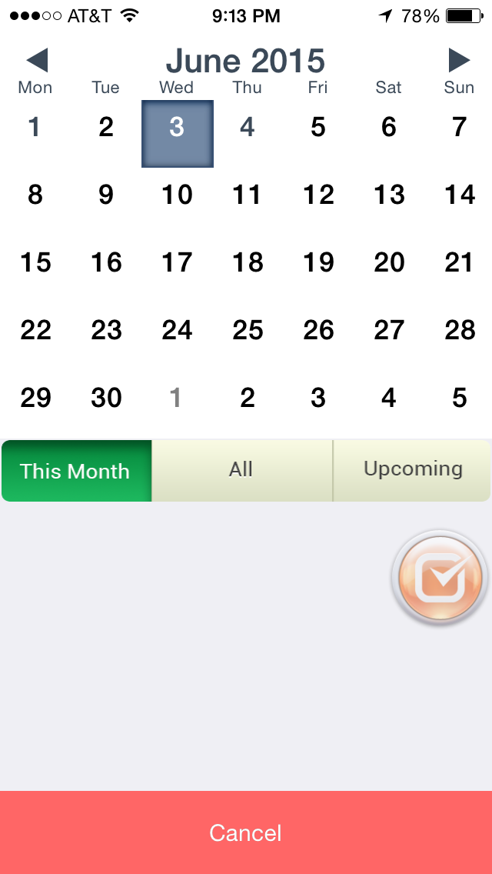
Trophy can be added to calendar day for making target

Slide 36
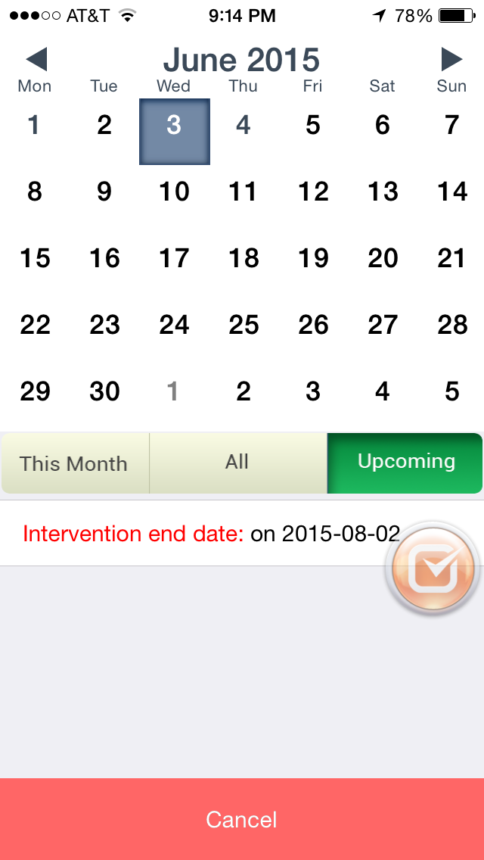
Intervention end date --> Intervention Ends On
2015-08-02 --> 2nd Aug 2015
Or 2 Aug 2015

Slide 37
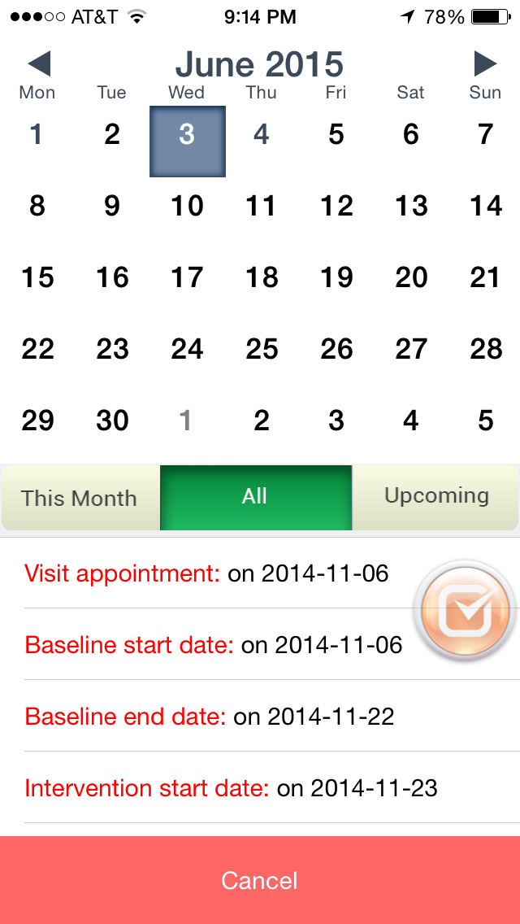
Change date format from 2015-08-02 etc --> 2 Aug 2015 etc

Slide 38
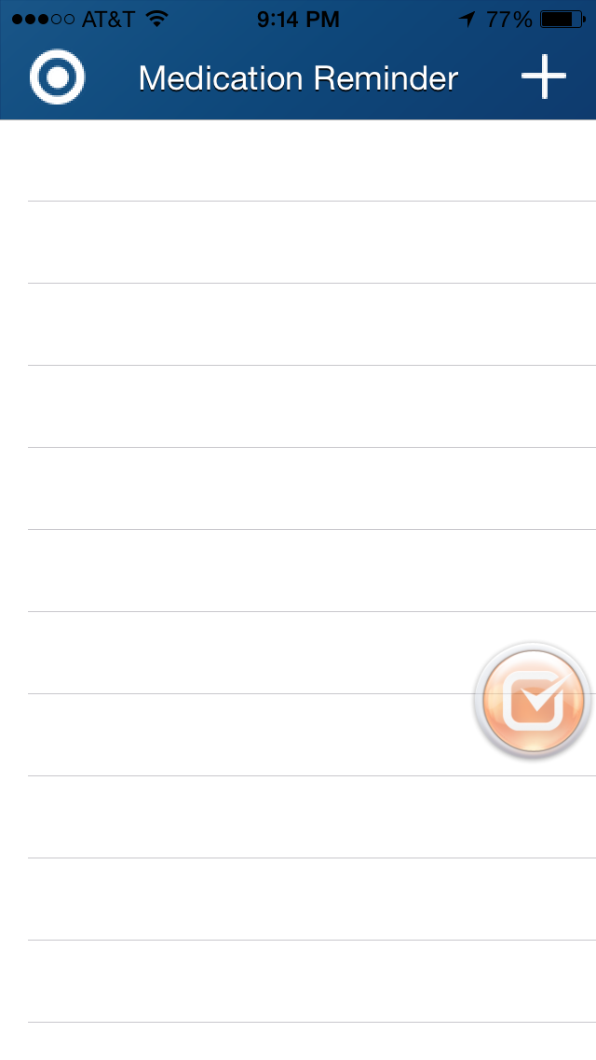

Slide 39
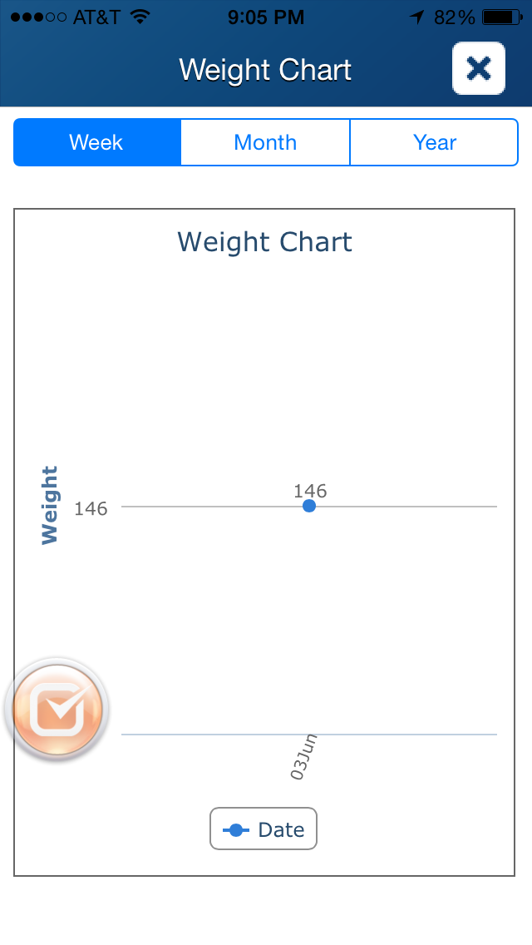
Put lbs after weight on side

Slide 40
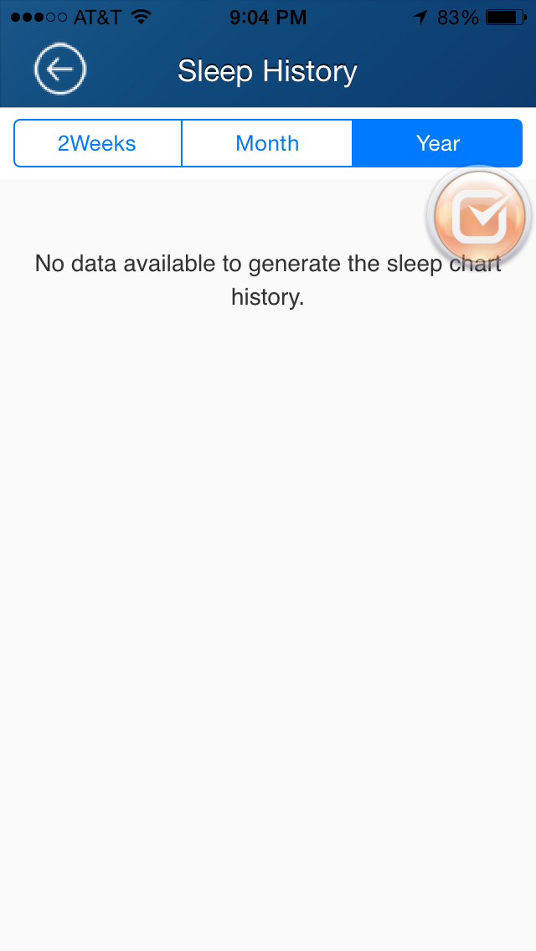

Slide 41
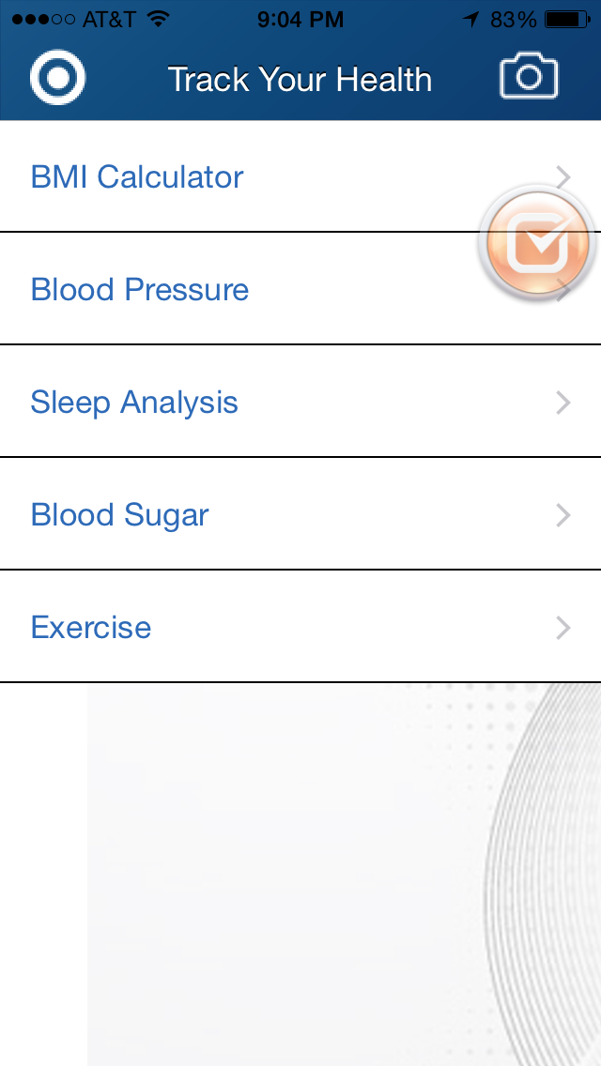
Different font for these tabs

Slide 42
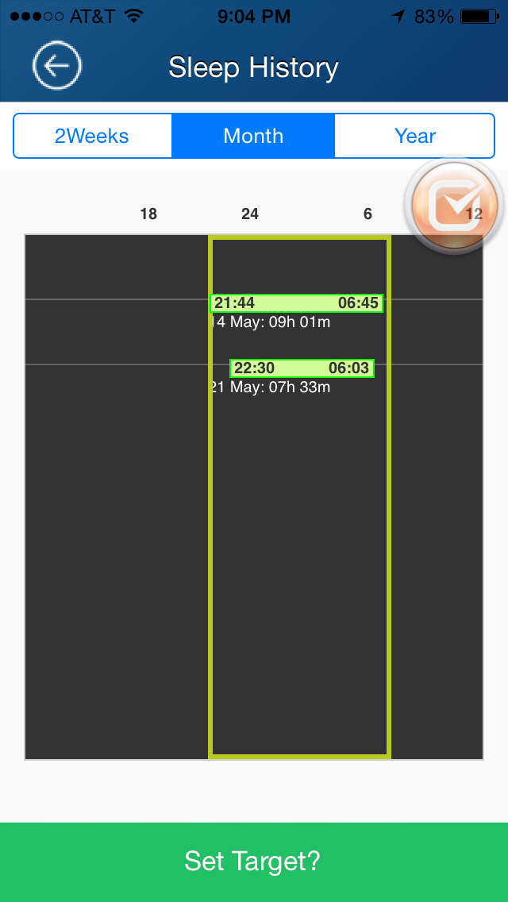
If “was this enough sleep?” is NO –
Then turn bar to orange.
Add this to FAQs

Slide 43
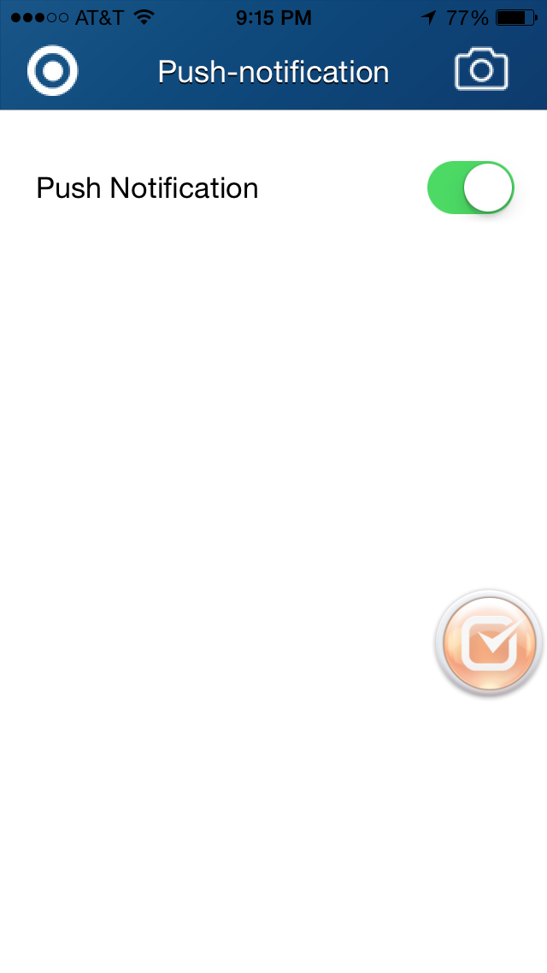
Make note of being on or off
Push-notification --> Push Notifications

Slide 44
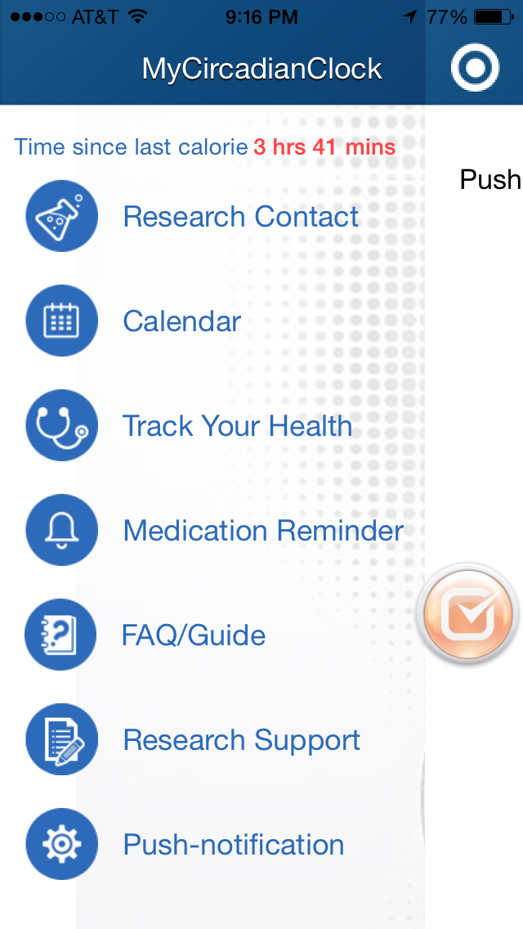

Slide 45
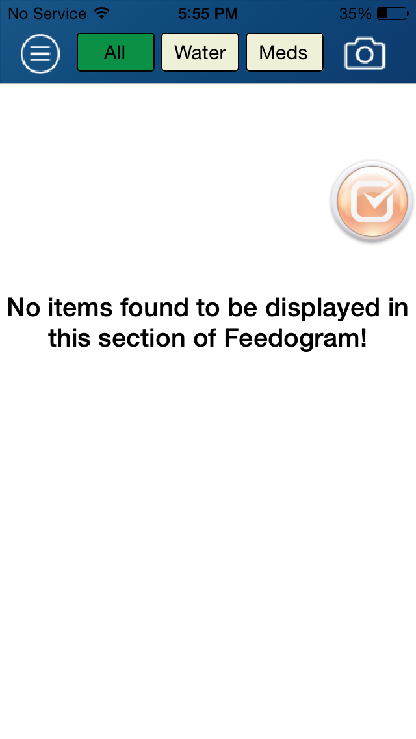
What is this?
this section of Feedogram -> this section.

Slide 46
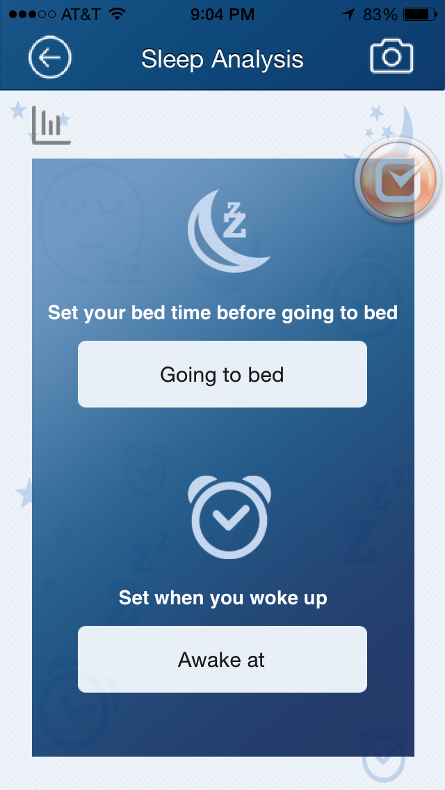
Set your .. to bed --> Enter Bedtime
Set when you woke up --> Wake Up Time
Awake at: --> I Woke Up At

Slide 47
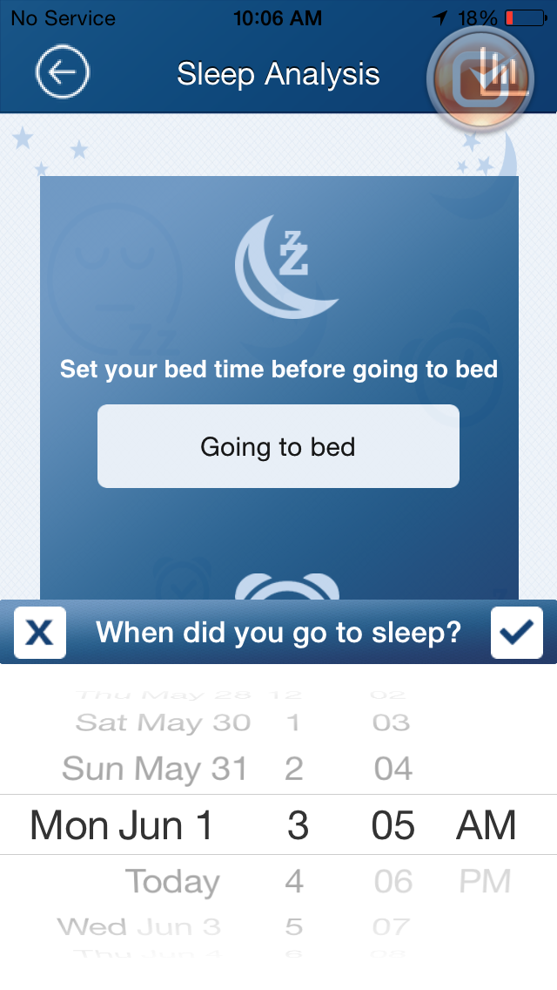
Should auto set to PM for first question.

Slide 48
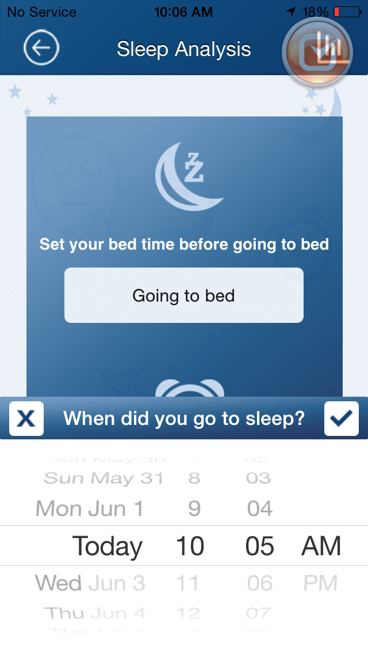
Same as last page?

Slide 49
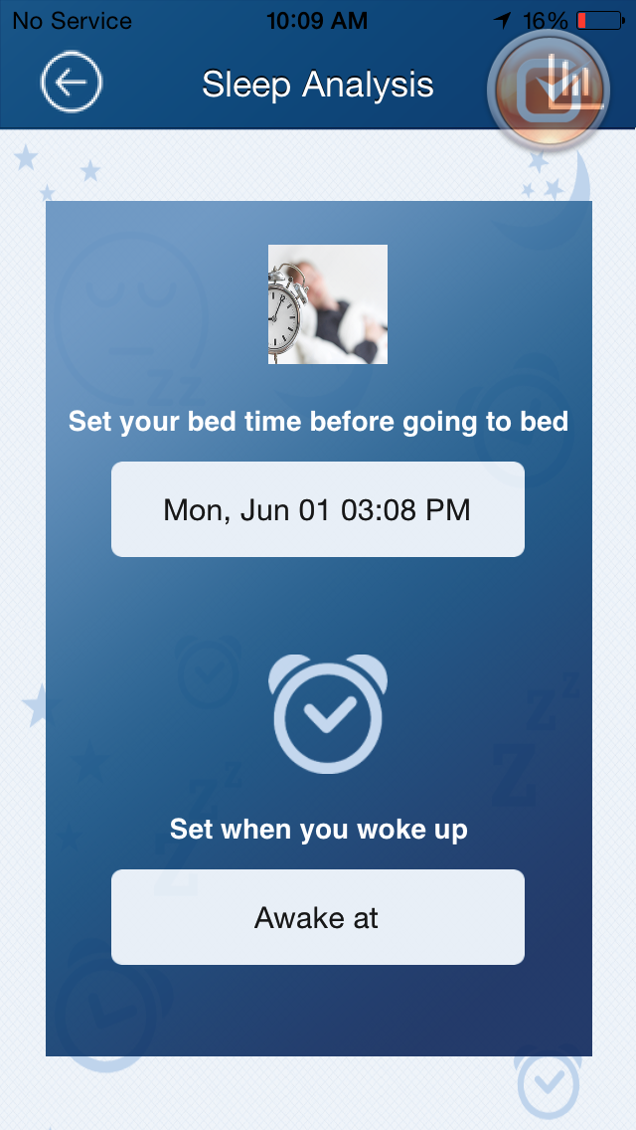

Slide 50
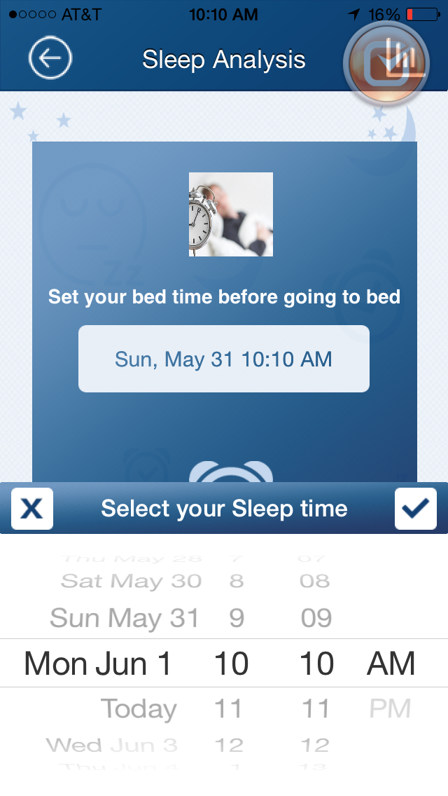
START HERE

Slide 51


Slide 52


Slide 53

Get a star for meeting sleeping goal
Notes:
can skip this feature

Slide 54

In food collage date range, the dates are wrongly shown. Instead of 2015, it shown 2014 for Jan-June.
change date format to 01-Jan-2015 etc

Slide 55

Medly --> Medley
How can I view --> How can I view the
Can I use the app in offline? --> Can I use the app offline?
Why feedogram menu is not coming? --> Why does my feedogram fail to display?
Can I record medicine... --> How do I record my medicine intake?
How to send food image? --> How do I send my food photo?

Slide 56

Why white circle??
Can I send multiple Food.. --> F of food should be lowercase
/few time ago --> a little while ago
is there any way to ... -> When's my next appointment?
You can also refer the ...--> You can also refer to the events in the calendar section.

Slide 57


Slide 58


Slide 59


Slide 60


Slide 61


Slide 62

Are you sure to ... --> Please confirm that you want to edit this reminder.

Slide 63

Enter your medicine name --> Enter medicine name.

Slide 64


Slide 65


